Slide 1
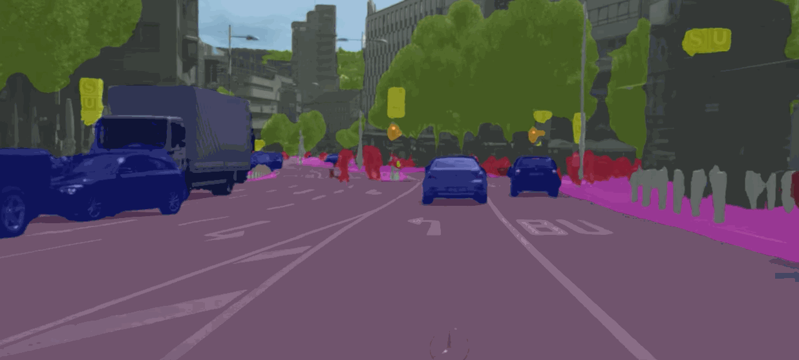
Image Segmentation
Image Segmentation: Divide image into important segments

Slide 2
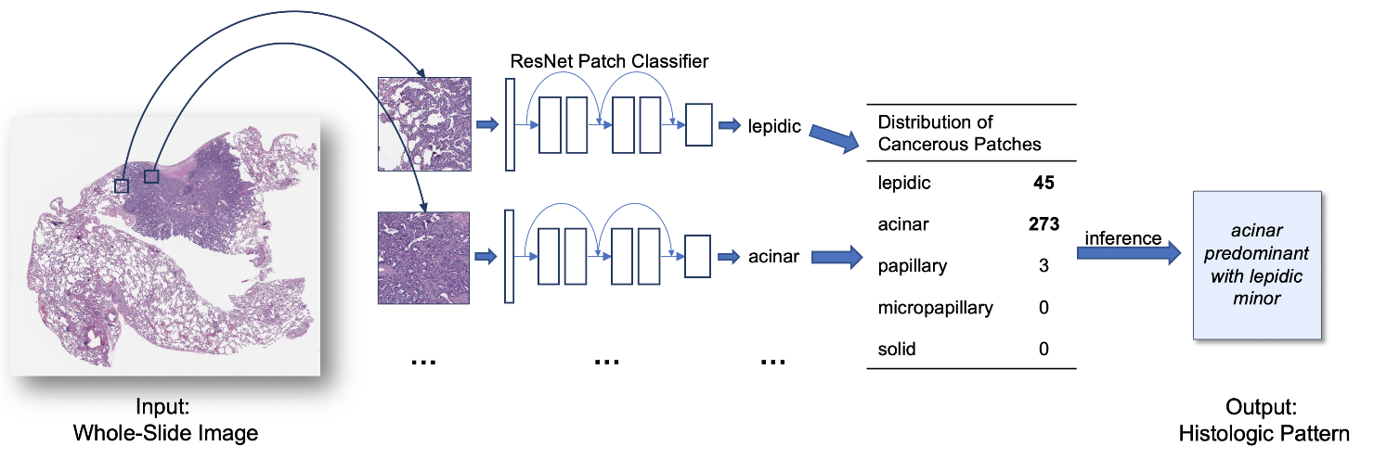
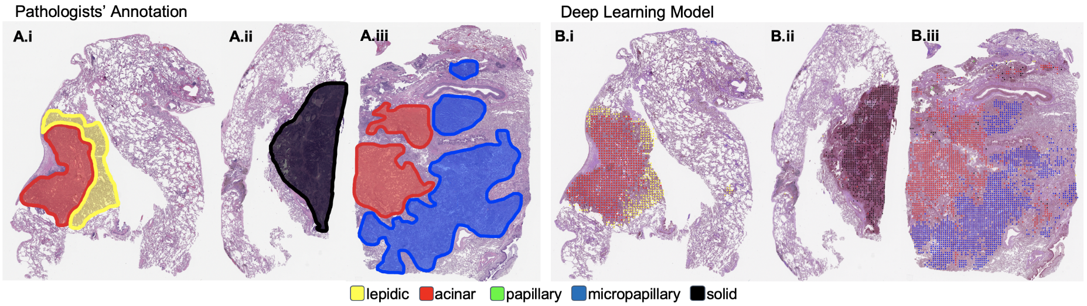
AI Pathology
Artificial Intelligence Now Classifies Lung Cancer as well as Pathologists
Jason W. Wei, Laura J. Tafe, Yevgeniy A. Linnik, Louis J. Vaickus, Naofumi Tomita, Saeed Hassanpour, Pathologist-level classification of histologic patterns on resected lung adenocarcinoma slides with deep neural networks, Scientific Report, 2019.

Slide 3
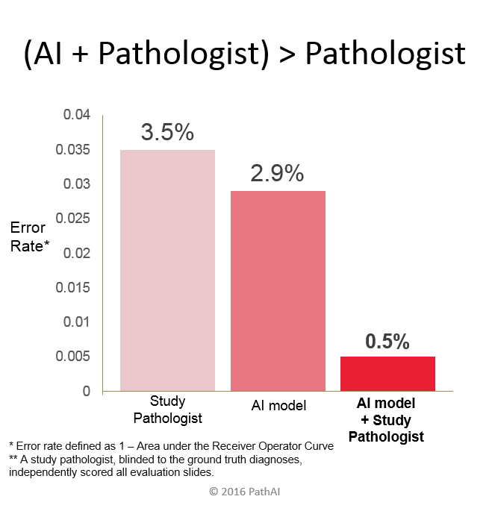
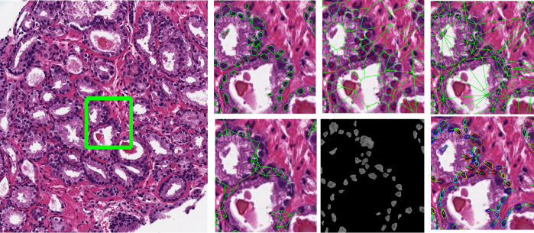
AI + Pathologist
Combining Deep Learning with Pathologists, AI Drops Error Rate for Breast Cancer Diagnoses by 85%

Slide 4
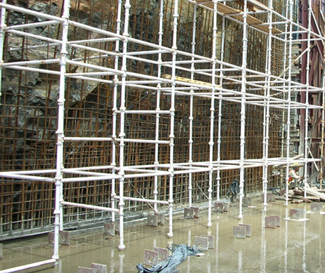
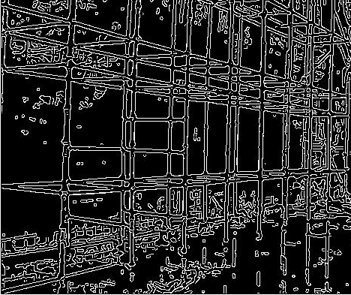
Image Segmentation
We use AI segmented images/videos for temporary scaffolding structure health monitoring

Slide 5
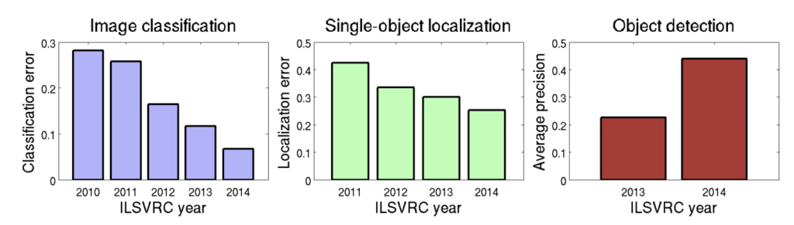
From Classification to Segmentation
Source: Fei-Fei Li, Andrej Karpathy & Justin Johnson (2016) cs231n, Lecture 8 — Slide 8, Spatial Localization and Detection (01/02/2016). Available: http://cs231n.stanford.edu/slides/2016/winter1516_lecture8.pdf

Slide 6
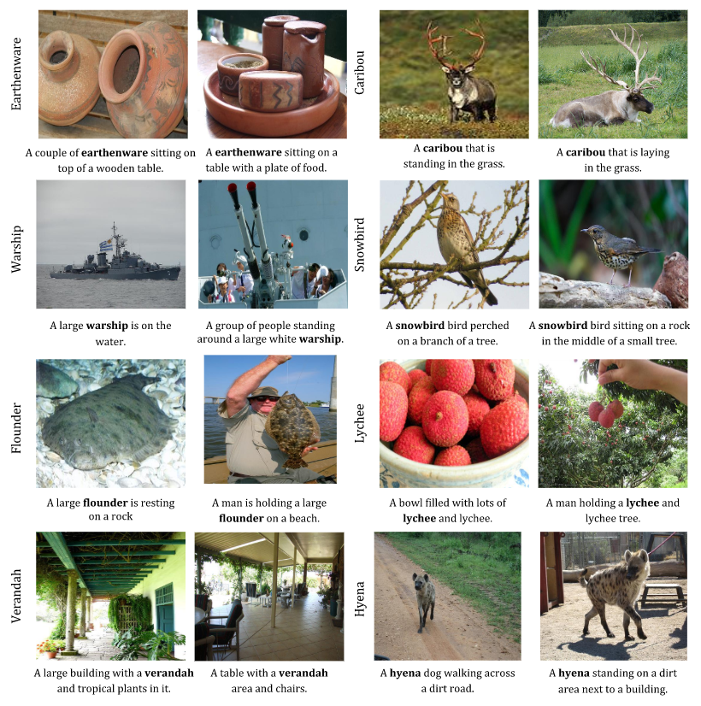
Image Captioning
Automatically captioning a complex image
Source: descriptions generated by NOC on images from MSCOCO and ImageNet

Slide 7
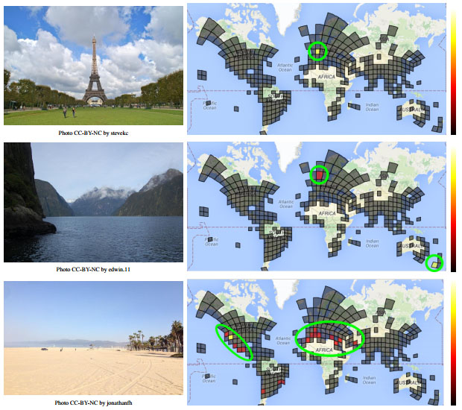
Image Localization
PlaNet is capable of detecting locations of almost any images
Source: Google PlaNet

Slide 8
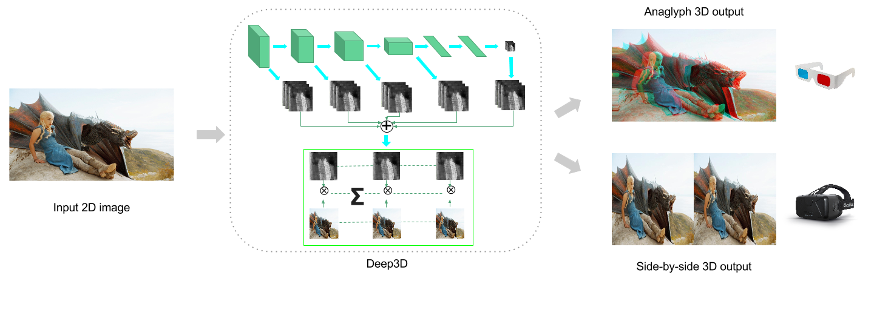
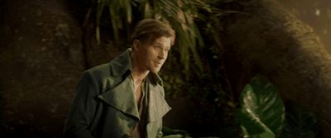
2D-3D Image Transformation
Deep3D can transform 2D images into 3D images
Source: Deep3D

Slide 9
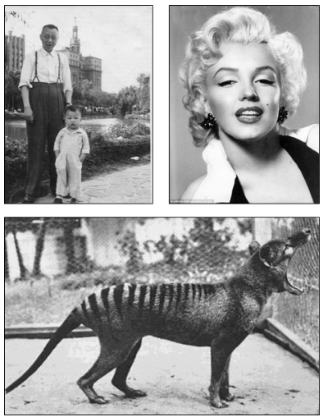
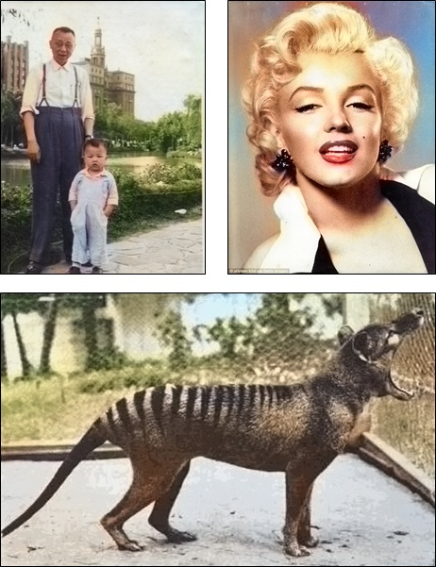
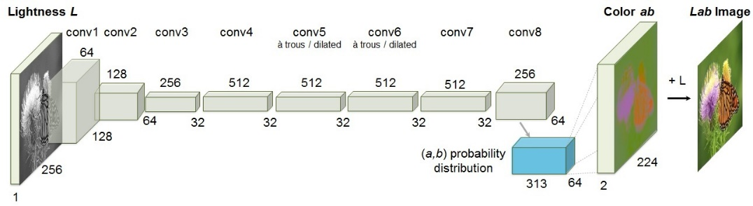
Image Colorization
Automatic Coloring can convert a black-white image to a colorful image
https://arxiv.org/pdf/1603.08511.pdf

Slide 10
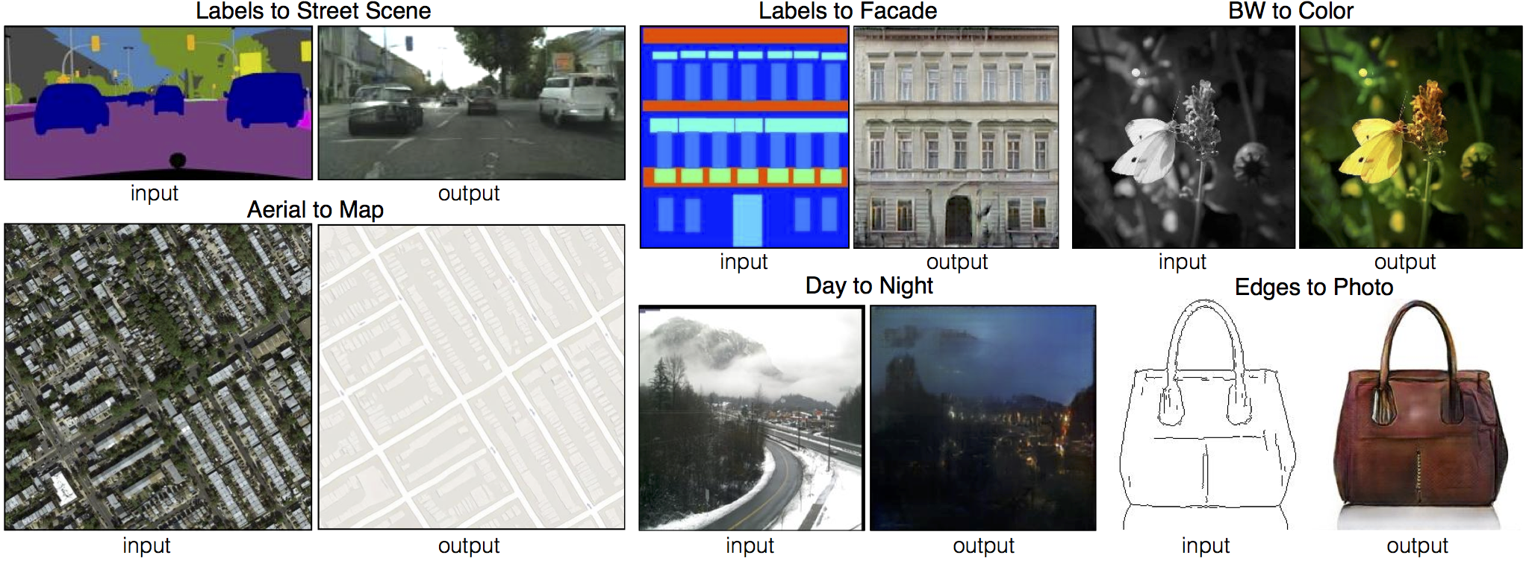
Image-to-Image Translation
Image-to-Image Translation can be applied as a generic solution to any image translation problems such as synthesizing photos from label maps, reconstructing objects from edge maps, etc.
Source: pix2pix https://affinelayer.com/pixsrv/

Slide 11
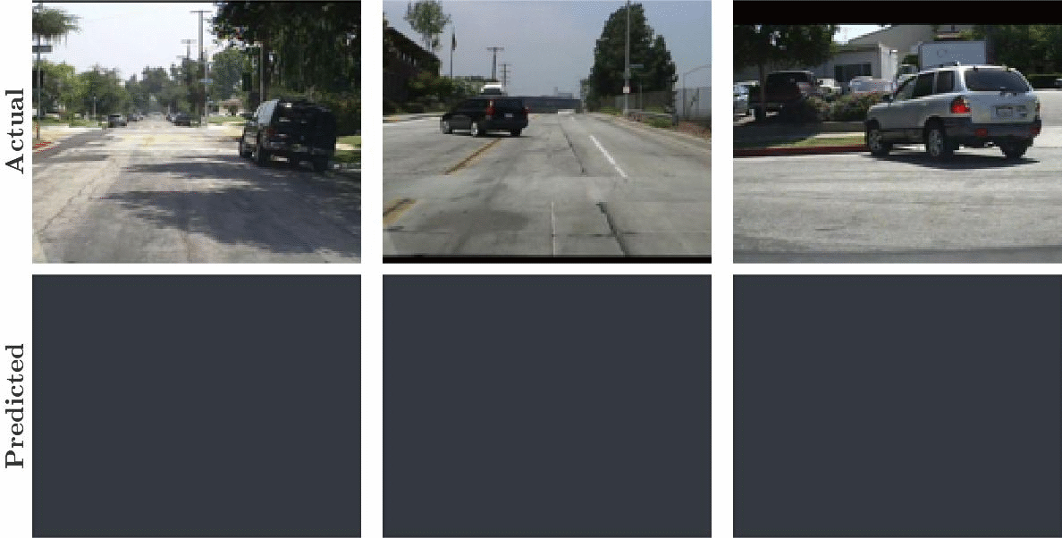
Predict Future Video Frames
PredNet can predict the future frames in a video sequence, which can be used to predict movements of rendered objects.
Source: PredNet

Slide 12
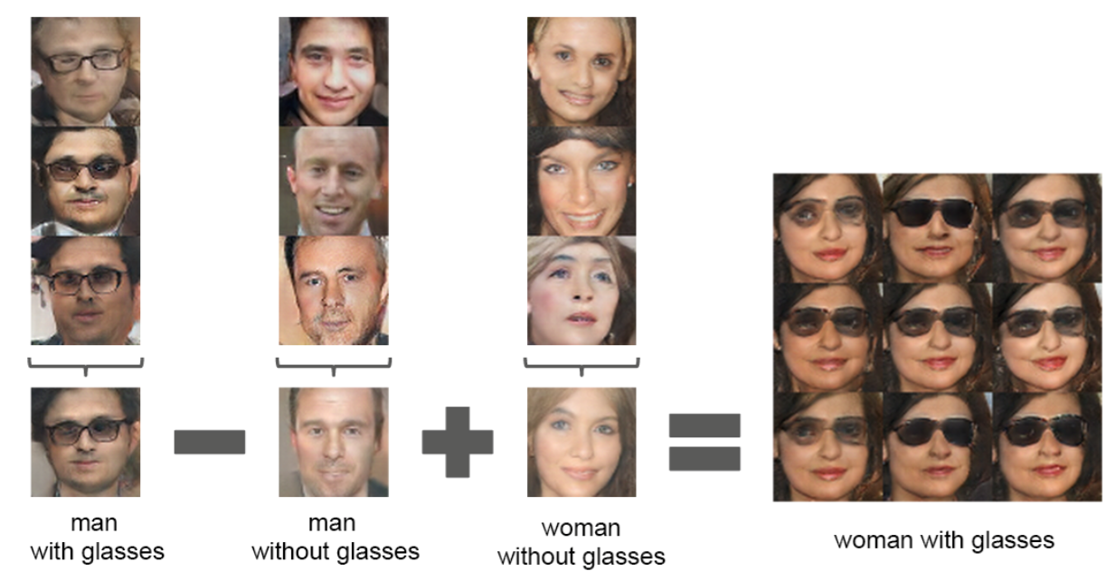
Try to remember

Slide 13
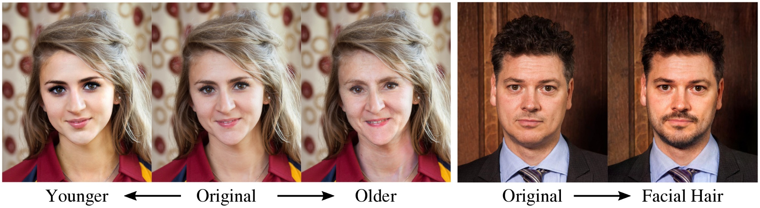
Image Semantic Transformation
Semantic transformation on Images by deep feature manipulations: add glasses, make older/younger, add smile
Source: Deep Feature Interpolation https://research.cs.cornell.edu/dfi/

Slide 14
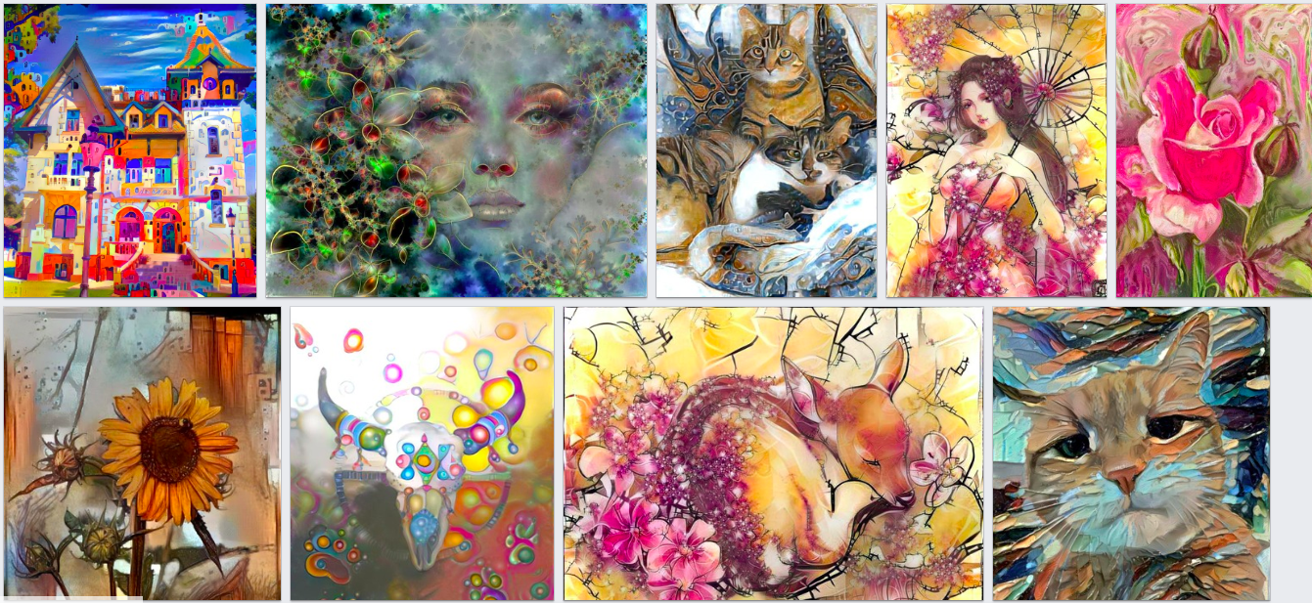
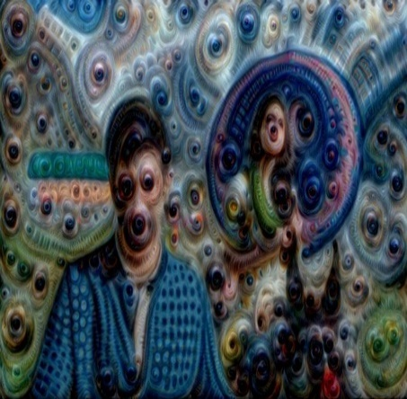
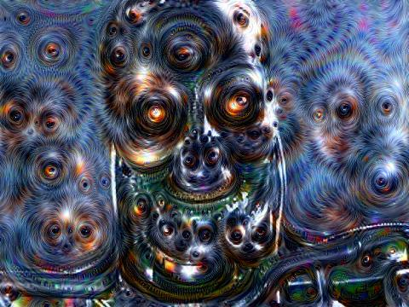
Can AI create a dreamland?
DeepDream is a powerful computer vision algorithm that uses a convolutional neural network to find and enhance certain patterns in images.
Source: DeepDream

Slide 15
Agenda
Artificial Intelligence
From ANI to AGI to ASI
An example of deep learning in Computer Vision
Recent Advance in AI Technologies
Generative Models
Reinforcement Learning
Ensemble-based Learning
Transfer Learning
Pitfalls and Risks in AI
Adversarial Examples

Slide 16
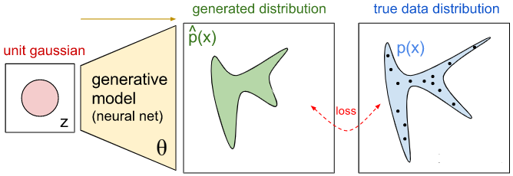
Generative Models
Generative Model can generate data mimicking the target data distribution.

Slide 17
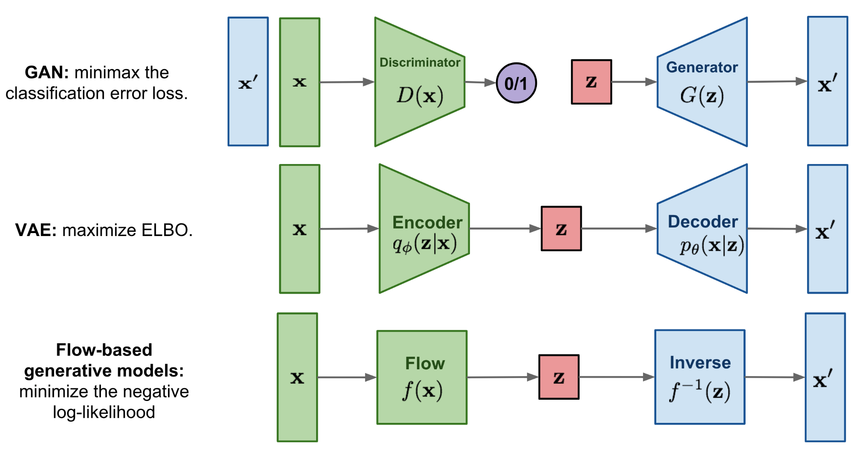
Deep Generative Models
Image Source:
https://lilianweng.github.io/lil-log/2018/10/13/flow-based-deep-generative-models.html
Notes:
ELBO: evidence lower bound

Slide 18
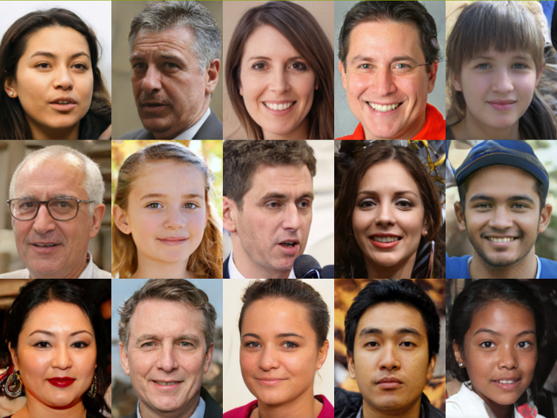
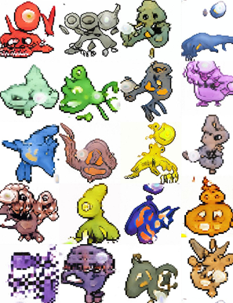
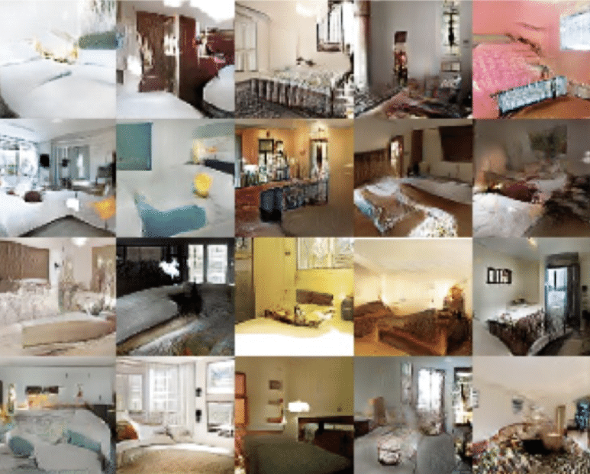
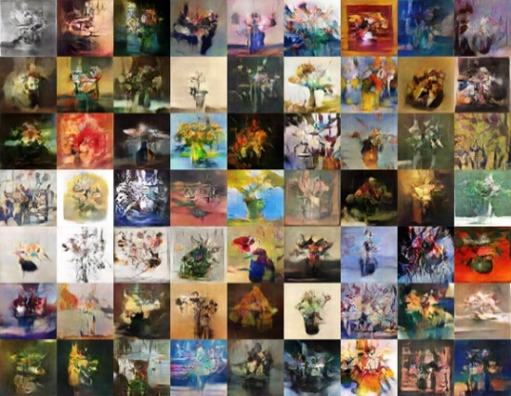
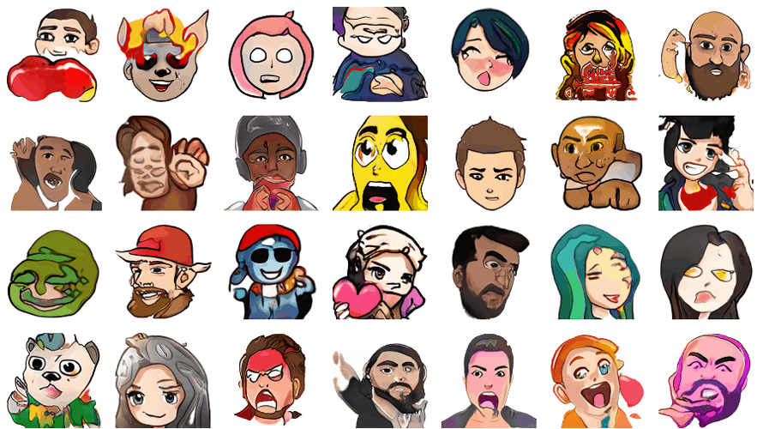
Virtual Reality by AI Generative Models
Human Faces
Pokémon's
Bedrooms
Art
Cartoons

Slide 19
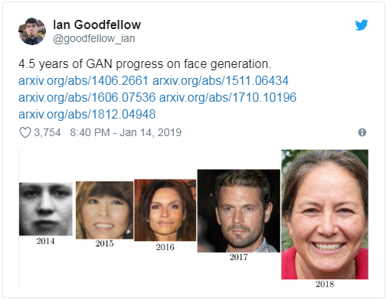
4.5 Years of GAN Progress on Face Generation

Slide 20
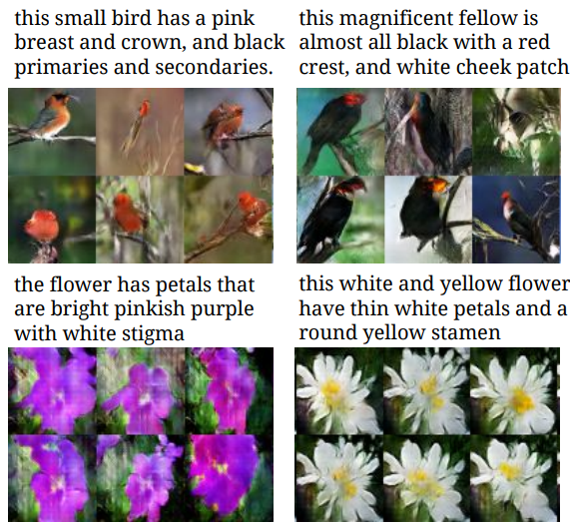
Image Generation – From Descriptions
Deep Generative Models can translate abstract, visual concepts from characters to pixels.
Source: Generative Adversarial Text to Image Synthesis, https://arxiv.org/pdf/1605.05396.pdf

